Slide 1
VP160 Recitation Class 6
by Li Chunchao
2016/7/4

Slide 2
Short Review

Slide 3

Lagrangian Mechanics
Genralized coordinates and velcoties
Degrees of freedom
Hamilton's action
Hamilton's (least action) principle
Euler-Lagrange equations

Slide 4
Mometum
Momentum and conservation of momentum
Collisions
Center of Mass

Slide 5
Solving Problems

Slide 6
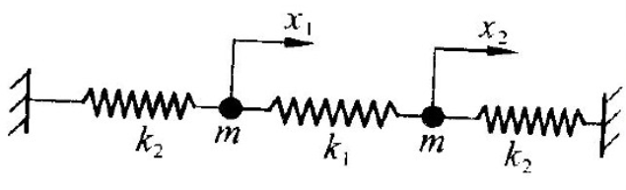
Lagrangian Mechanics
Two particles are fixed by three springs as followed. The particles and springs are all on a table. Find out the equation of motion.

Slide 7
Momentum
One day, Mr. Kong want to buy 5kg rice from Mr. Li. Mr. Li dump the rice uniformly. When the reading on the weighter is 5kg. Mr. Li stop dumping. Mr. kong think the final on the weighter is less than 5kg. Is he right?

Slide 8
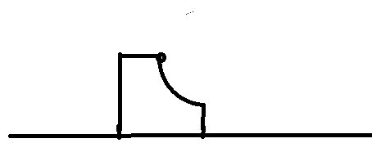
Momentum
A particle with mass m move down from a curved surface with mass M. Find the speed when the small particle leave the surface. All surface is smooth. The lowest part of curved surface is horizontal. The height of curved surface is h.

Slide 9

Collision
Find the speed of two balls after collicsion when
It is an elastic collision
The coefficient of restitution is e.

Slide 10
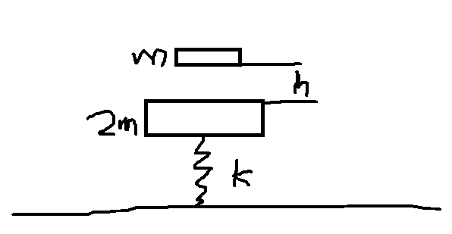
Collision
The collision is elastic. The second collision happened at the same place. All bulks are static as t=0. Find h.

